Slide 1
Greenhouse Sensor
P Aadhith Sanjay

Slide 2
ABOUT The Project
A greenhouse (also called a glasshouse, or, if with sufficient heating, a hothouse) is a structure with walls and roof made chiefly of transparent material, such as glass, in which plants requiring regulated climatic conditions are grown.
These structures range in size from small sheds to industrial-sized buildings.
The interior of a greenhouse exposed to sunlight becomes significantly warmer than the external temperature, protecting its contents in cold weather.

Slide 3
PROBLEM
Sunlight
Since most of the plants require sunlight for faster growth maintaining a certain amount is necessary
Temperature
Certain plants thrive in a particular temperature ranges
Electricity
Greenhouses use a lot of electricity so using sensors to can help reduce the electricity used
COSTS
Can help reduce the costs

Slide 4
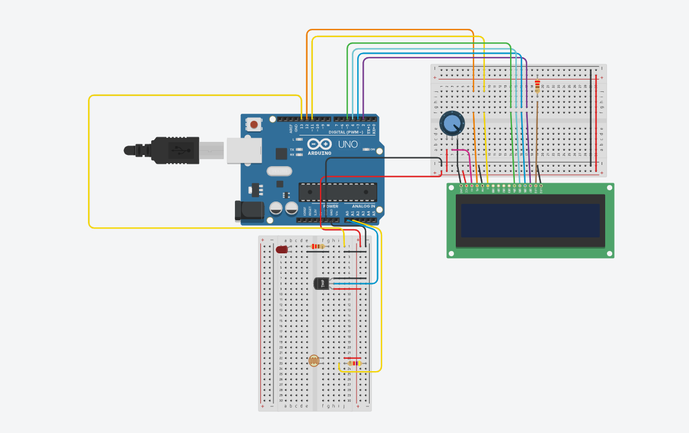
Circuit

Slide 5
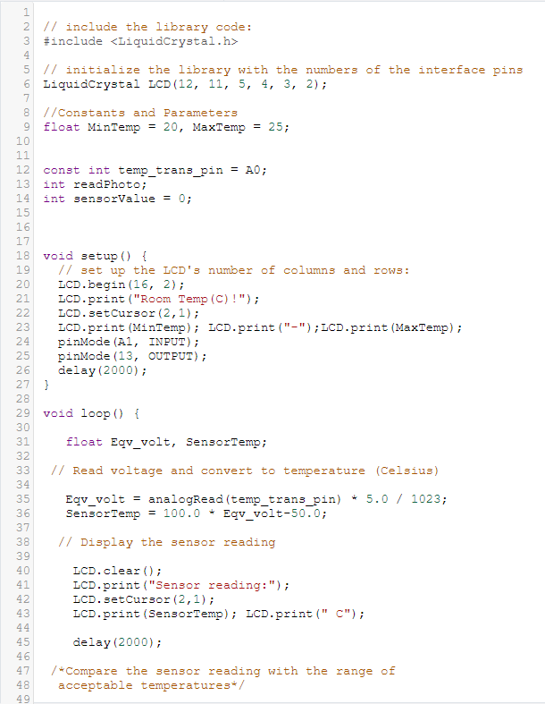
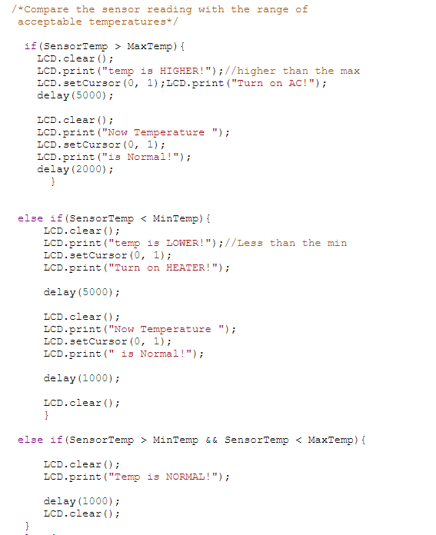
Code

Slide 6
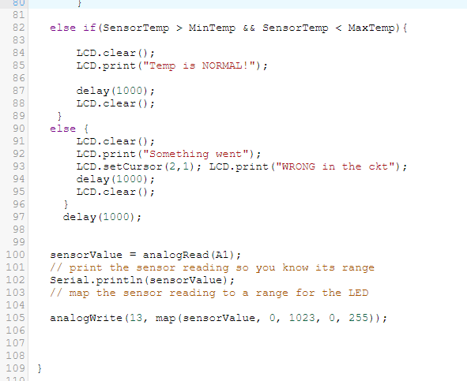

Slide 7
THANK YOU

